Slide 1
A Model For Network Security
Network Security

Slide 2
A Model For Network Security
Objectives of the Topic
After completing this topic, a student will be able to
describe a model for network security.

Slide 3
A Model For Network Security
Figures and material in this topic have been
adapted from “Network Security Essentials: Applications and Standards”, 2014, by William Stallings.

Slide 4
A Model For Network Security
Assume a message is to be transferred from one party to another across some sort of Internet service.
The two parties, who are the principals in this transaction, must cooperate for the exchange to take place.

Slide 5
A Model For Network Security
A logical information channel is established by defining a route through the Internet from source to destination and by the cooperative use of communication protocols (e.g., TCP/IP) by the two principals.

Slide 6
A Model For Network Security
To protect the information from an opponent who may present a threat to confidentiality, authenticity, and so on, security comes into play.
All of the security techniques have two components:

Slide 7
A Model For Network Security
1. A security-related transformation on the information to be sent.
Example1: encryption of the message, which scrambles the message so that it is unreadable by the opponent.

Slide 8
A Model For Network Security
Example2: the addition of a code based on the contents of the message, which can be used to verify the identity of the sender.

Slide 9
A Model For Network Security
2. Some secret information shared by the two principals and unknown to the opponent.
E.g. encryption key used with the transformation to scramble the message before transmission and unscramble it on reception.

Slide 10
A Model For Network Security
A trusted third party (TTP) may be needed to achieve secure transmission.
E.g. a TTP may be responsible for distributing the secret information to the two principals while keeping it from any opponent.

Slide 11
A Model For Network Security
This general model shows that there are four basic tasks in designing a particular security service:

Slide 12
A Model For Network Security
1. Design an algorithm for the security-related transformation. An opponent should not be able to defeat purpose of the algorithm.
2. Generate the secret information used by the algorithm.

Slide 13
A Model For Network Security
3. Develop methods for the distribution and sharing of the secret information.
4. Specify a protocol enabling the principals to use the security algorithm and the secret information for a particular security service.

Slide 14
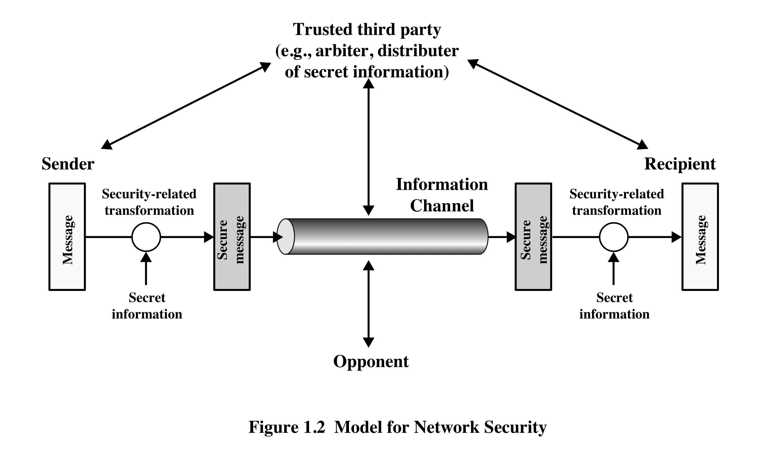
A Model For Network Security
A Generic Model For Network Security

Slide 15
A Model For Network Security
Next, we describe a general model which reflects a concern for protecting an information system from unwanted access.
E.g. A hacker who attempts to penetrate system that can be accessed over a net.

Slide 16
A Model For Network Security
An intruder can be a disgruntled employee who wishes to do damage or a criminal who seeks to exploit computer assets for financial gain (e.g., obtaining credit card numbers or performing illegal money transfers).

Slide 17
A Model For Network Security
Using this model requires us to:
Select appropriate gatekeeper functions to identify users
Implement security controls to ensure only authorized users access designated information or resources.

Slide 18
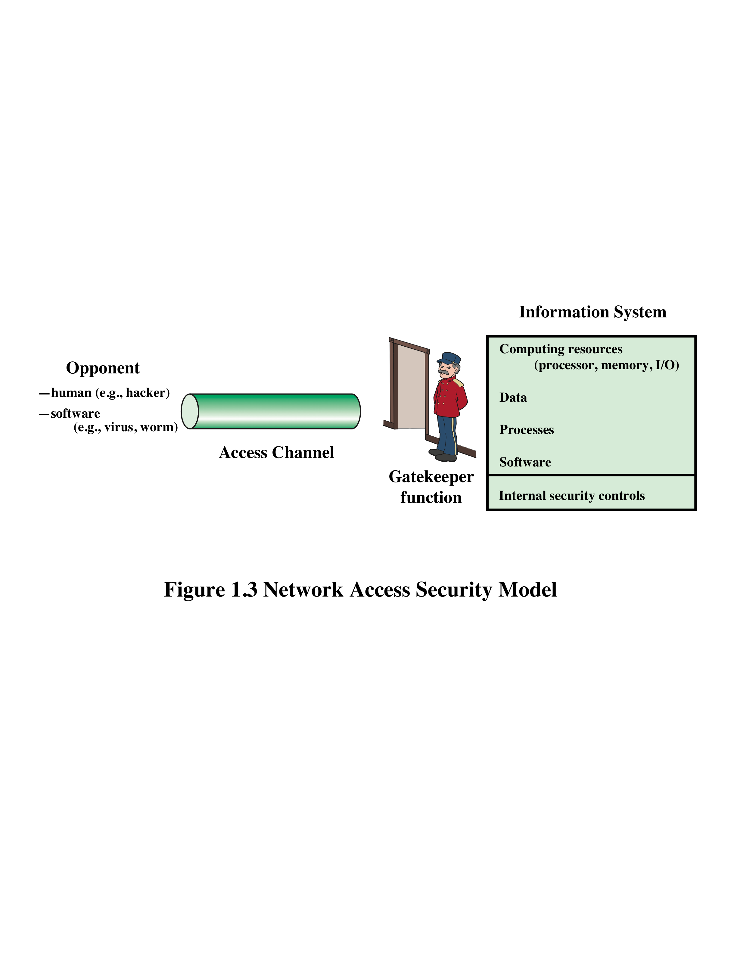
A Model For Network Security
Network Access Security Model

Slide 19
A Model For Network Security
Another type of unwanted access is the placement in a computer system of logic that exploits vulnerabilities in the system and that can affect application programs.
End

